Slide 1

KAFKA (FOUNDATIONS, CONSUMERS AND PRODUCERS)
BY CARLOS SOTO

Slide 2


Slide 3
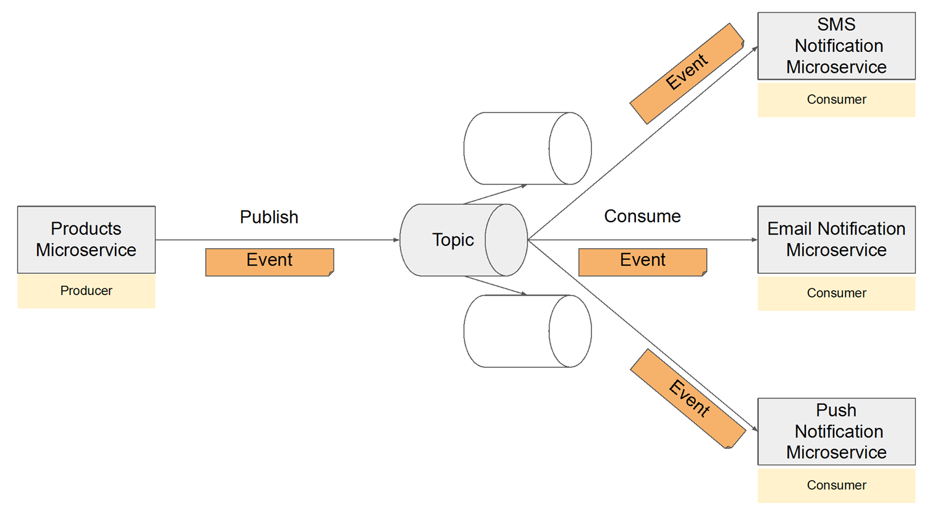

Slide 4
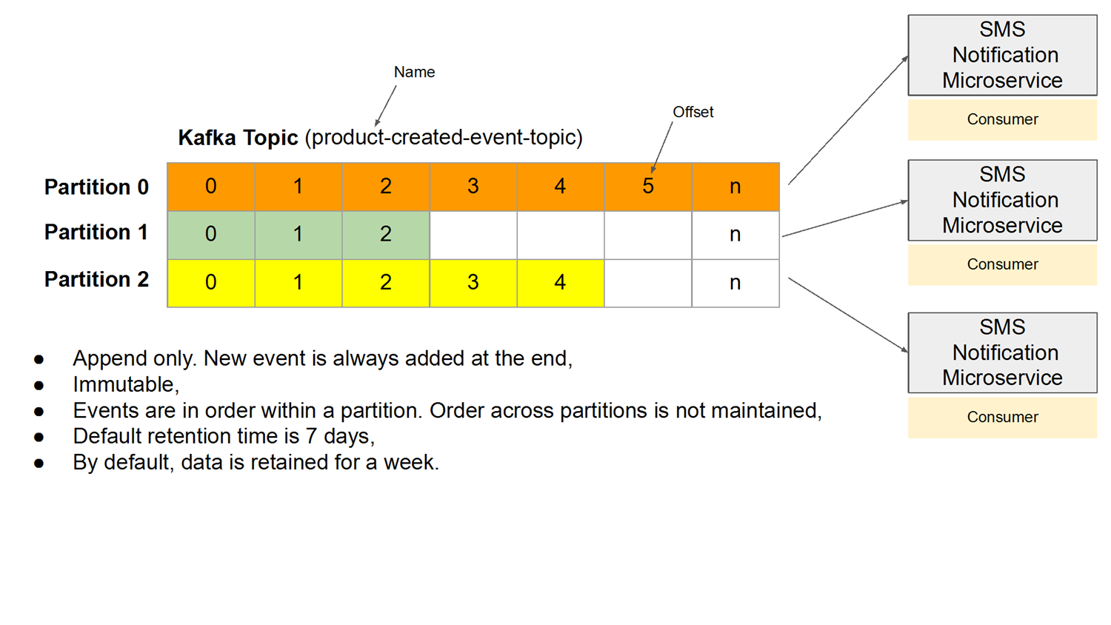

Slide 5

Basic analogy to understand the fundamental concepts in Kafka
Topic → Newspaper
Partition → Newspaper sections
Offset → Page number within a section
Consumer Group → Teams of readers that split up the sections so they can read without duplicating work

Slide 6


Slide 7
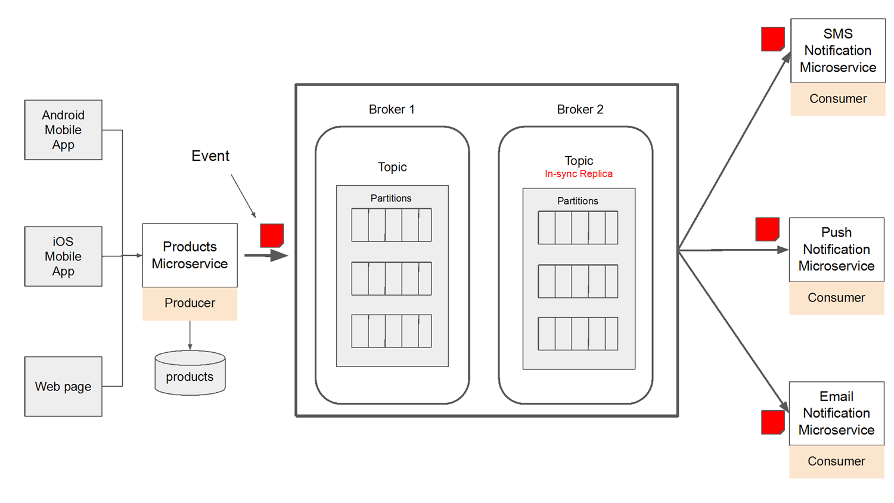

Slide 8
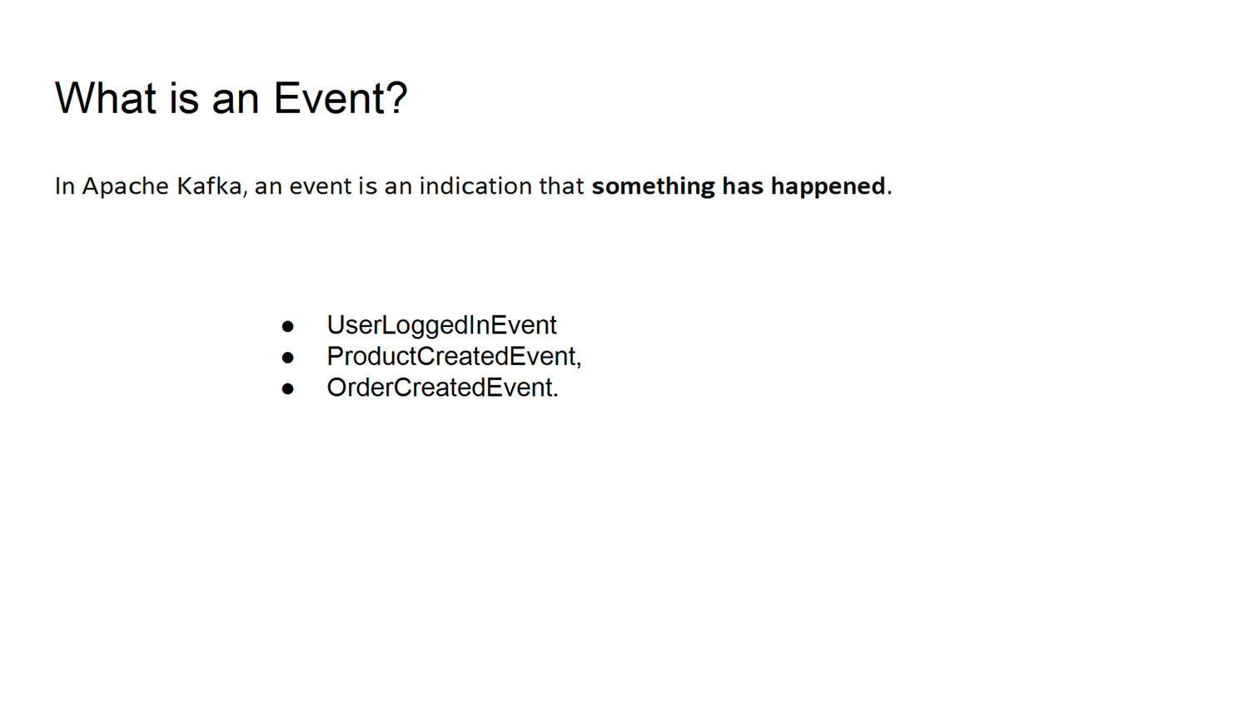

Slide 9
